Slide 1
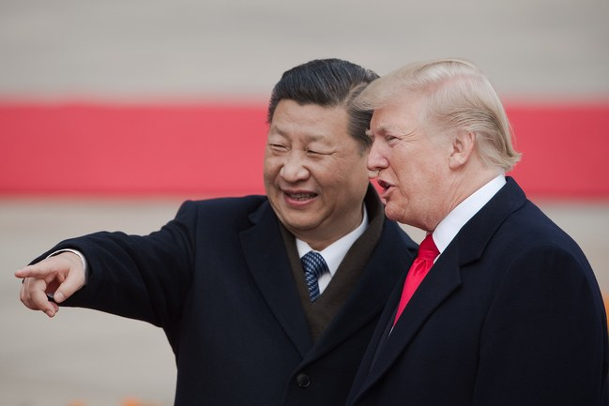
Is China Winning the Trade War ?
https://www.newyorker.com/news/our-columnists/why-china-is-winning-the-trade-war

Slide 2
Is China Winning the Trade War ?
https://www.newyorker.com/news/our-columnists/why-china-is-winning-the-trade-war

Slide 3
Distributed Representation of Chinese Collocation
Bo Xia and Endong Xun

Slide 4
Distributed Representation of Chinese Collocation
Bo Xia and Endong Xun

Slide 5
Introduction
What is collocation?
Why collocation is meaningful for us?
How to represent a collocation?

Slide 6
What is collocation?
Introduction
English collocation

Slide 7
What is collocation?
Introduction
English collocation

Slide 8
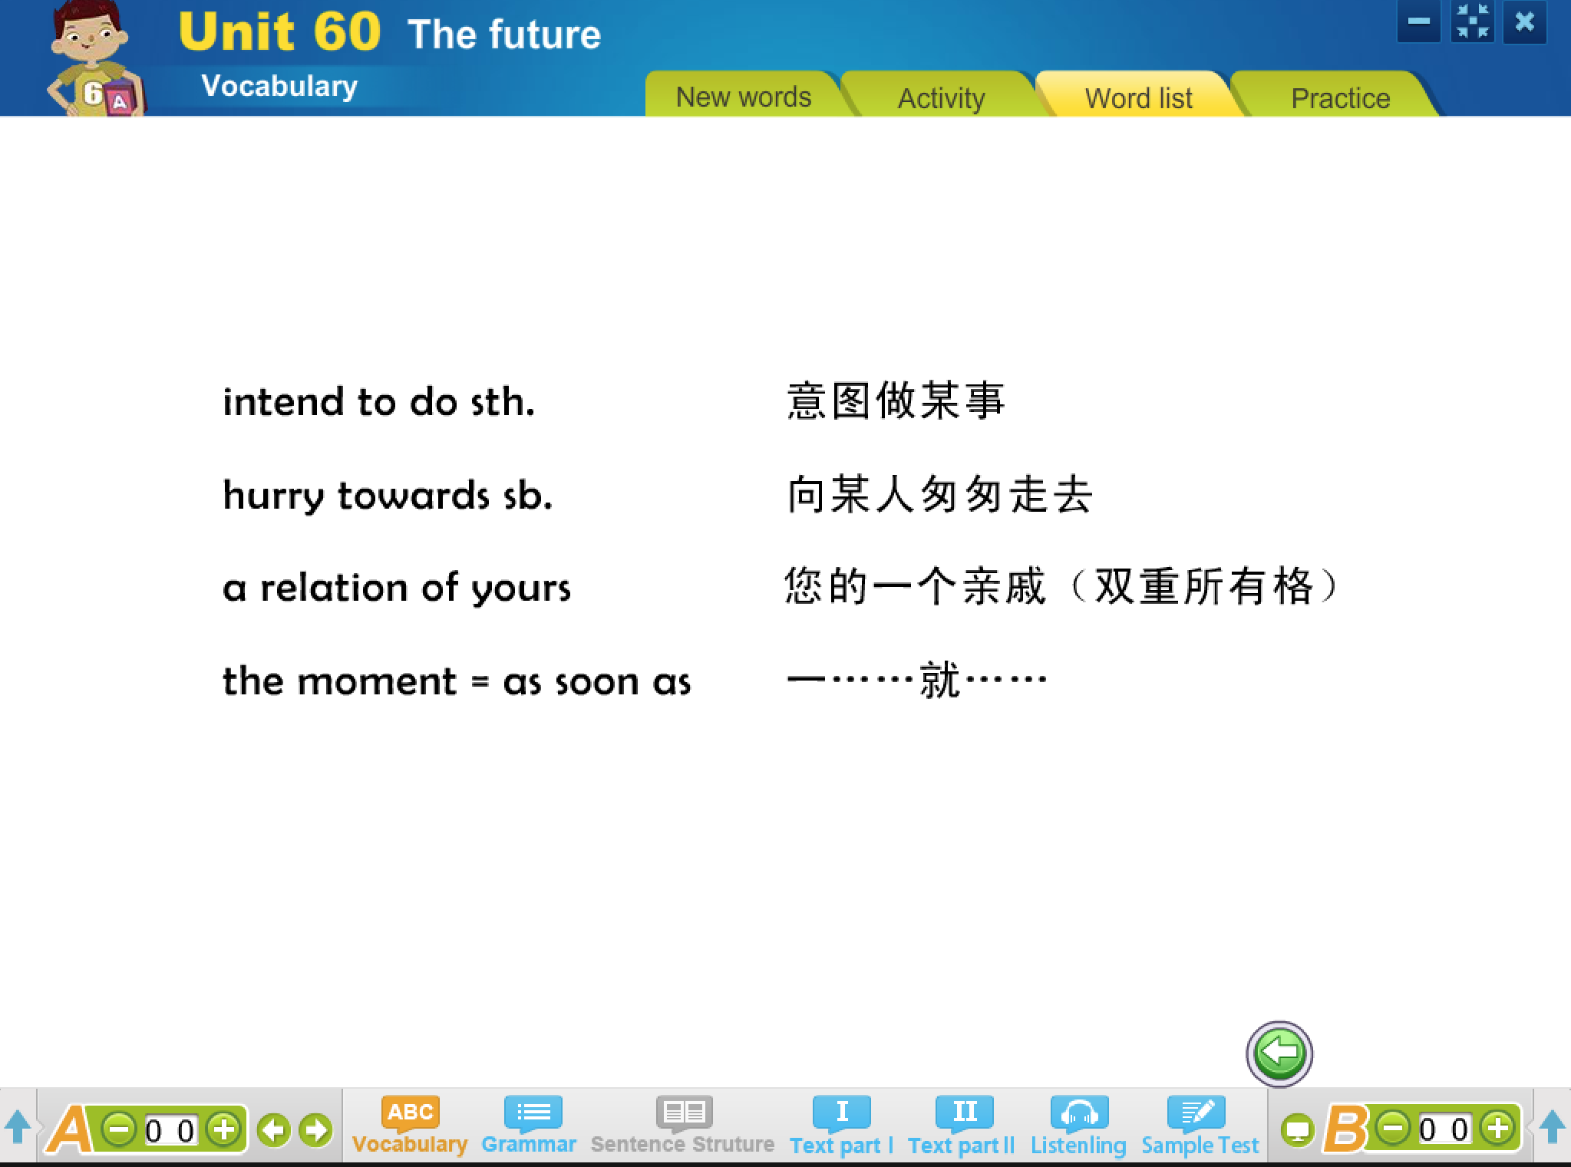
What is collocation?
Introduction
English collocation

Slide 9

What is collocation?
Notes:
Collocation examples from compulsory English lesson

Slide 10
decrease to
die out
in peace
burst into laughter
appreciate doing sth
before long
for sure
in relief
according to
have an effect on
in danger of
protect A from B
long before
come into being
so that
pat attention to
in such a short time
succeed in doing sth
Notes:
Collocation examples from compulsory English lesson

Slide 11
What is collocation?
Introduction
English collocation
Chinese collocation

Slide 12
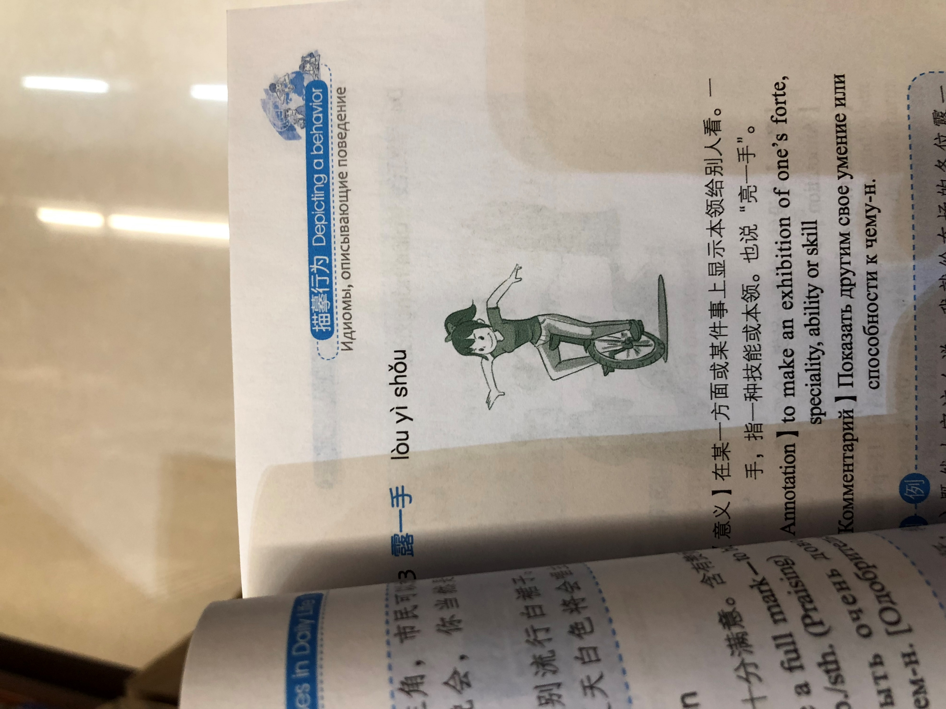
Chinese collocation
Introduction
露一手
【Annotation】
to make an exhibition of one’s forte, speciality, ability or skill

Slide 13
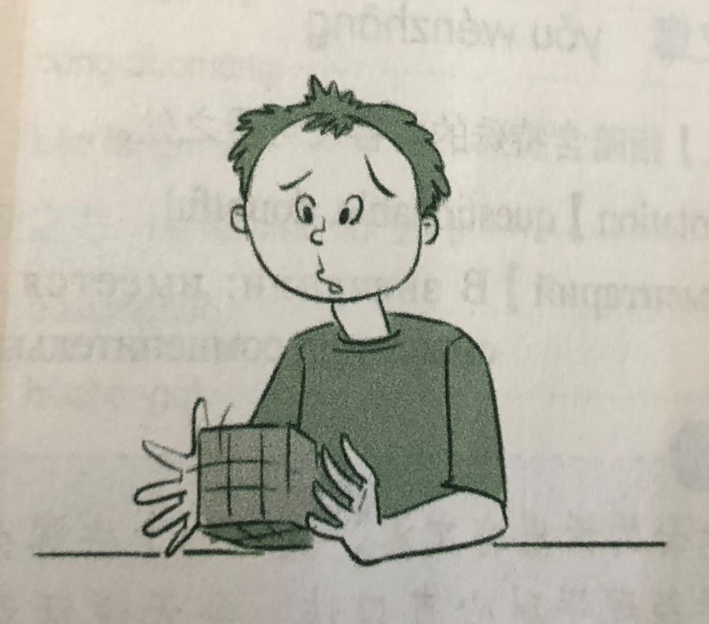
Chinese collocation
Introduction
伤脑筋
【Annotation】
Knotty, troublesome, causing sb. enough headache

Slide 14

Chinese collocation
Introduction
做白日梦
【Annotation】
To build castles in the air, to daydream(Ironic)

Slide 15
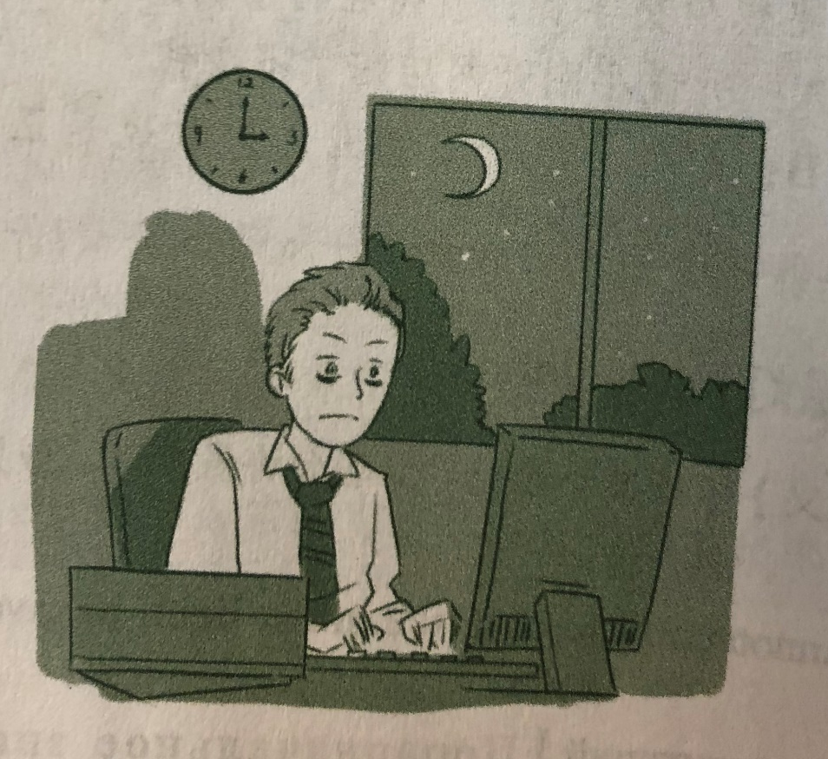
Chinese collocation
Introduction
开夜车
【Annotation】
To drive at night – to work late into the night or by candlelight, to put in extra time at night, to burn the midnight oil.

Slide 16
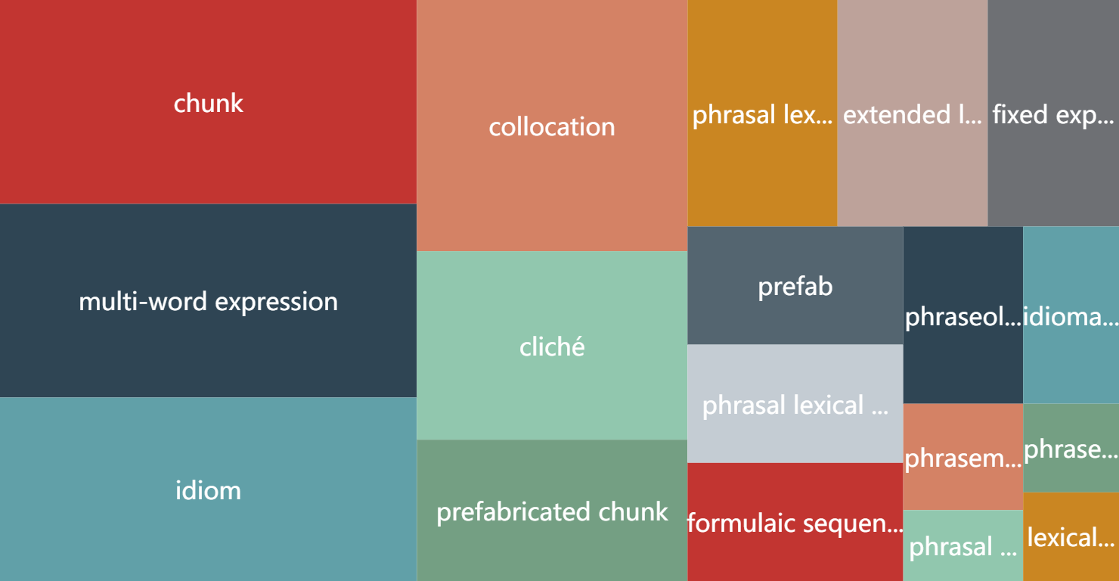
What is collocation?
Notes:
{name: 'collocation', value: 160},
{name: 'idiom', value: 180},
{name: 'chunk', value: 200},
{name: 'multi-word expression', value: 190},
{name: 'cliché', value: 90},
{name: 'extended lexical unit', value: 80},
{name: 'fixed expression', value: 70},
{name: 'formulaic sequence', value: 60},
{name: 'idiomatic expression', value: 40},
{name: 'lexical phrase', value: 20},
{name: 'phraseme', value: 30},
{name: 'phraseologism', value: 20},
{name: 'phraseological unit', value: 50},
{name: 'phrasal lexical item', value: 60},
{name: 'phrasal lexeme', value: 20},
{name: 'phrasal lexeme', value: 80},
{name: 'prefabricated chunk', value:90},
{name: 'prefab', value: 60},

Slide 17
Why collocation is meaningful for us?
Introduction
Important role of language phenomenon in syntactic and semantic,
But need to use it well.
e.g.
look up
bus stop
Notes:
通过歧义的例子，表达清楚搭配是一个重要的概念，搭配处理得好，parsing就能处理的好，其他任务也能处理的好

Slide 18
How to represent a collection?
Introduction
Lexicon
Table
Triple
Rules, Features or labels
e.g.
< ‘make’ , ‘decision’ >
< ‘make’ , ‘decision’, ‘verb–object’ >
Notes:
截图对应的描述方法

Slide 19
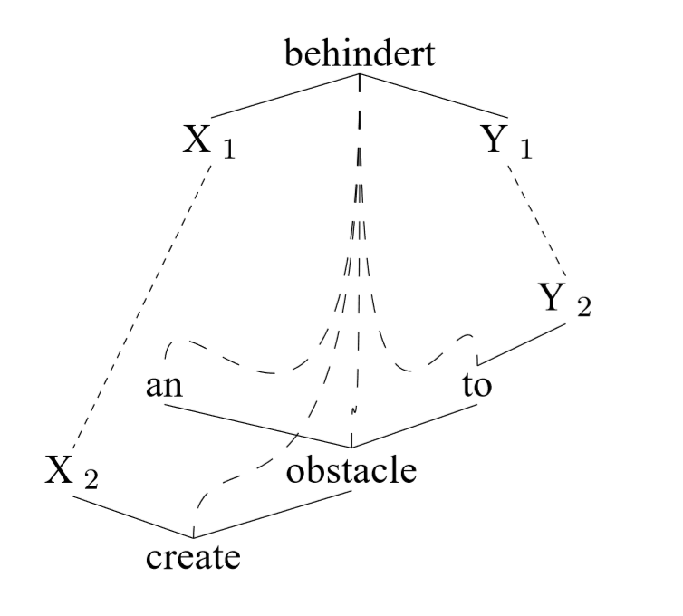
Example of a typical syntactic MWE configuration

Slide 20
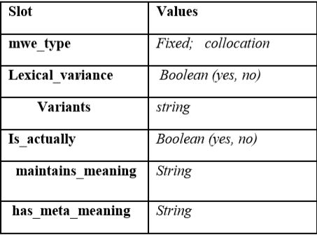
A conceptual lexicon
Development of a lexicon
of the encoding of MWEs
and their treatments.
Example of encoding schema for nouns & verbs

Slide 21
Basic Notions
A Neural Probabilistic Language Model
Collocation
NNLM + Collocation = ?

Slide 22

Basic Notions
A Neural Probabilistic Language Model
Collocation
NNLM + Collocation = ?

Slide 23
Basic Notions
A Neural Probabilistic Language Model
Collocation
NNLM + Collocation =
Distributed Representation of Collocation

Slide 24
Basic Notions
“
By collocation,
we mean a directed association of head word and dependency word
that constructed by fully random combination
in a sentence.
”

Slide 25
Model Architecture
The objective of Collocation prediction
Continuous Skip-gram Model
A combination of ontology and hierarchical softmax

Slide 26

The objective of Collocation prediction
Model Architecture
P (Context(HEAD) | DEP)

Slide 27
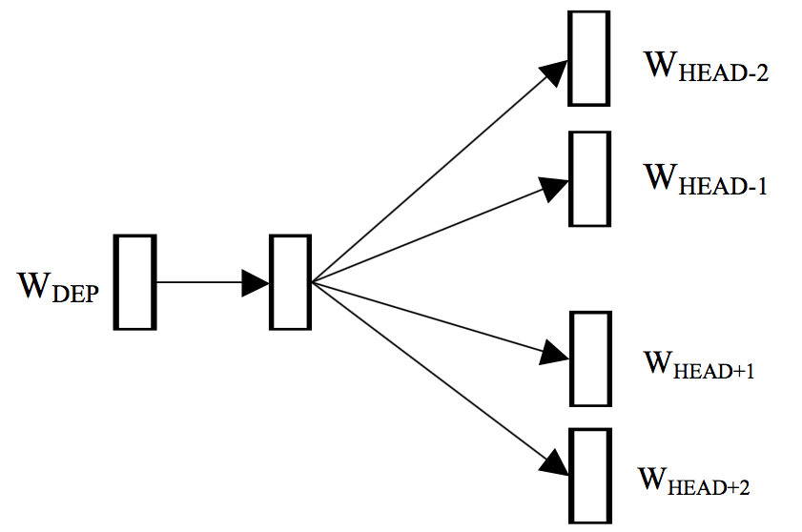
Continuous Skip-gram Model
Model Architecture
consider each DEP word representation as a bag of HEAD word contexts
The DEP word predicts surrounding words given the HEAD word of current collocation.

Slide 28
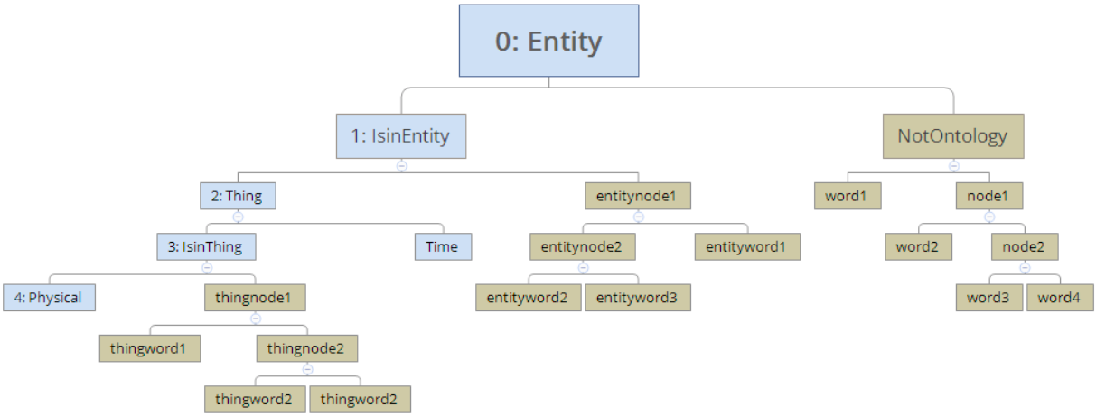
A combination of ontology and hierarchical softmax
Model Architecture

Slide 29

Experiment

Slide 30
Experimental setup
Experiment
100,000,000 sentence, with 3,377,634,987 Chinese tokens of roughly 100,906 words.
Averaged sentence length of test set is 14.79 by word

Slide 31
Neighbors of one collocation
Experiment
主张 | proposal | 后空翻 | backward somersault
诉诸武力 | to appeal to arms | 接特卡切夫 | Tkachev (gymnasts)
一中一台 | Taiwanization | 直体 | straight
国统 | Ruling of KMT | 屈体 | pike
台独 | Taiwanization | 9.725 | 9.725

Slide 32
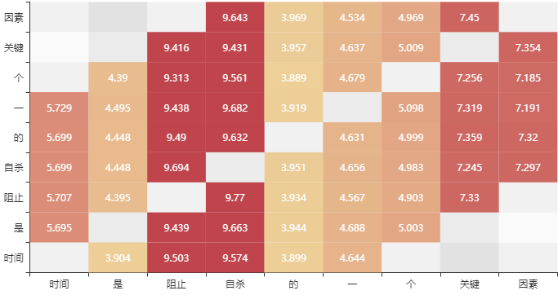
Measuring collocation intensity
Experiment

Slide 33
Verb-verb phrase recognition
Experiment
他/r 不/d 愿意/v 离婚/v ，/w 因为/c 这样/r 以后/f 他/r 也/d 不/d 可能/v 幸福/a 。/w
< 愿意, 离婚 >
以后 2.392401
离婚 0.986100
因为 0.710415
这样 0.651951
他 0.310175
不 0.273814

Slide 34
Verb-verb phrase recognition
Experiment
昨晚/t ，/w 股权/n 分置/v 改革/vn 试点/vn 工作/vn 宣布/v 启动/v
< 宣布, 启动 >
启动 5.668315
试点 3.171463
改革 0.476158
工作 0.409356
分置 0.313457

Slide 35
Verb-verb phrase recognition
Experiment
她/r 心里/s 拒绝/v 他/r 的/u 来到/v ，/w 因为/p 他/r 会/v 挤/v 走/v 现在/t 的/u 父亲/n 。/w
< 拒绝, 来到 >
心里 2.190928
来到 0.870547
因为 0.569144
她 0.312641
他 0.255559
的 0.224716

Slide 36
Verb-verb phrase recognition
Experiment
collocation-pretreatment | maximal verbs | if bi-directional | nCorrect | nTotal | Accuracy
TRUE | 3 | TRUE | 129 | 161 | 0.80124
TRUE | 4 | TRUE | 78 | 109 | 0.71559
TRUE | 5 | TRUE | 38 | 59 | 0.64406
TRUE | 3 | FALSE | 127 | 161 | 0.78881
TRUE | 4 | FALSE | 76 | 109 | 0.69724
TRUE | 5 | FALSE | 36 | 59 | 0.61016
FALSE | 3 | TRUE | 143 | 185 | 0.77297
FALSE | 4 | TRUE | 89 | 127 | 0.70078
FALSE | 5 | TRUE | 42 | 70 | 0.60000
FALSE | 3 | FALSE | 156 | 185 | 0.84324
FALSE | 4 | FALSE | 103 | 127 | 0.81102
FALSE | 5 | FALSE | 54 | 70 | 0.77142

Slide 37
Conclusion and future work
How it works in English Collocation ?
Does triple collocation feature can be learned?

Slide 38
Distributed Representation of Chinese Collocation
Bo Xia and Endong Xun
Beijing language and culture university
https://github.com/xiabo0816/Chinese_MWEs_Representation

Slide 39
Distributed Representation of Chinese Collocation
Bo Xia and Endong Xun Beijing language and culture university

